Slide 1

NSG Pilkington – University of Liverpool Machine Learning Project: 11/02/2021
Dr. Peter Green
Diego Echeverria
Risk Institute,
School of Engineering

Slide 2
List of activities
Comparison of bespoke filter (low-pass filter).
Eliminate input “9395 Main Gas Pressure (OP)” and run the model again.
Show “clean” and “exclusion” periods for the new data provided (2020-2021)
Chose the clean region with the largest number of data points as the training data.
Avoid “information leak” when standardising the testing data set.
Include the bias term in the linear regression equation.

Slide 3
List of activities
Comparison of bespoke filter (low-pass filter).
Eliminate input “9395 Main Gas Pressure (OP)” and run the model again.
Show “clean” and “exclusion” periods for the new data provided (2020-2021)
Chose the clean region with the largest number of data points as the training data.
Avoid “information leak” when standardising the testing data set.
Include the bias term in the linear regression equation.
All the following tasks have been obtained using a training dataset without correlated inputs and ignoring inputs whose time lags are < 1 hour

Slide 4

Bespoke filtering:
Using the uncorrelated inputs.
Bespoke filtering for the 3 out of 7 relevant inputs identified from the experiments on Test(1) and Test(2).
No filter Low-pass filter $Wn=0.1$ Low-pass filter $Wn=0.01$
Small changes in the MSE scores
 | LR | GP
Test (1) | 0.00046 | 0.00446
Test (2) | 0.00150 | 0.00610
Score | 0.00098 | 0.00528
 | LR | GP
Test (1) | 0.00043 | 0.00393
Test (2) | 0.00129 | 0.00597
Score | 0.00086 | 0.00495
 | LR | GP
Test (1) | 0.00039 | 0.00440
Test (2) | 0.00172 | 0.00631
Score | 0.00105 | 0.00535

Slide 5
List of activities
Comparison of bespoke filter (low-pass filter).
Eliminate input “9395 Main Gas Pressure (OP)” and run then model again.
Show “clean” and “exclusion” periods for the new data provided (2020-2021)
Chose the clean region with the largest number of data points as the training data.
Avoid “information leak” when standardising the training data set.
Include the bias term in the linear regression equation.

Slide 6
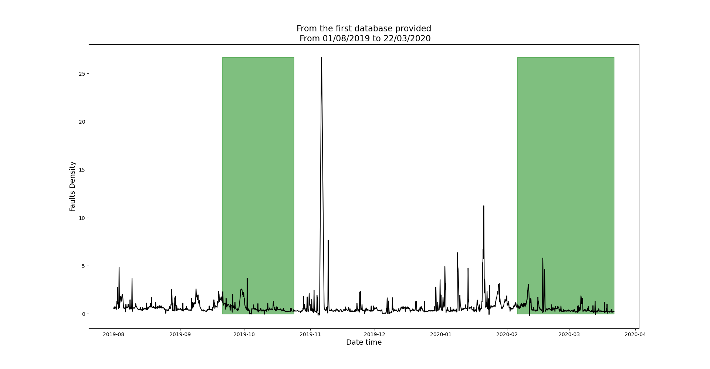
Test (1): Data from the first region is used for training
Clean regions
ISRA 5D
Training
Testing

Slide 7
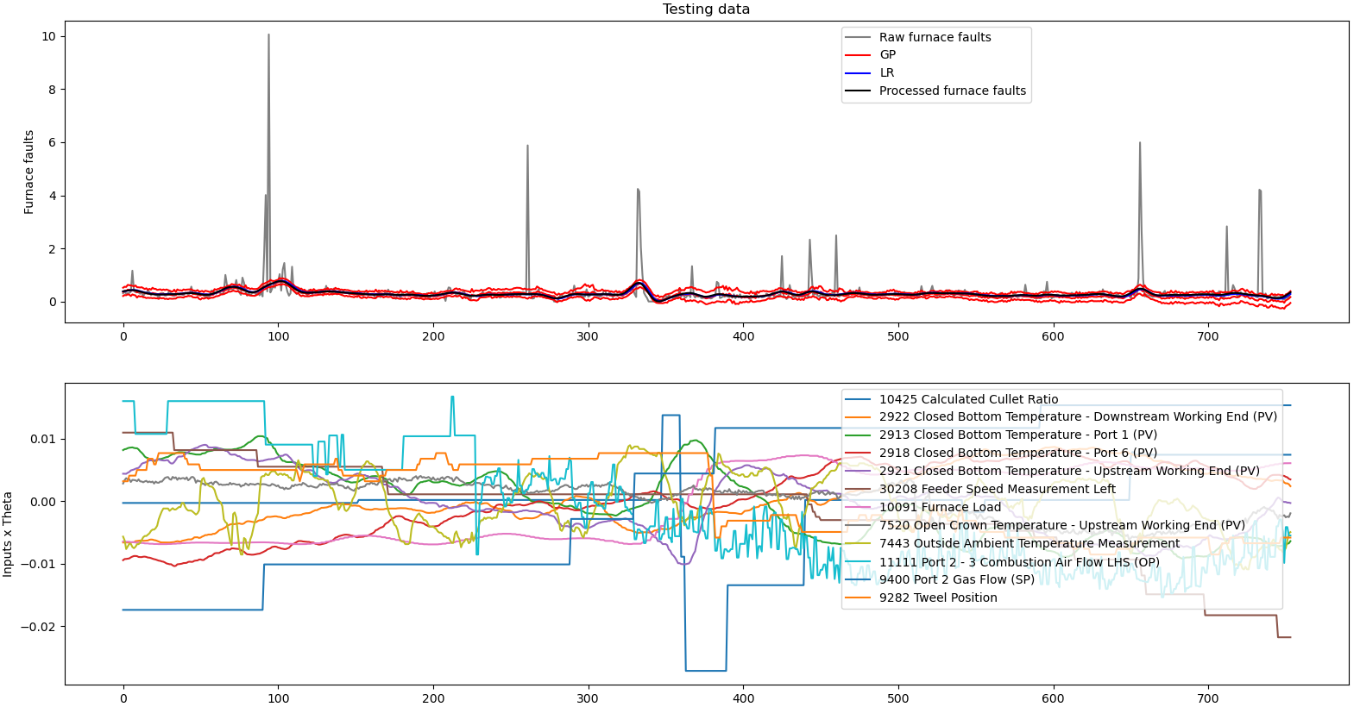
Test (1)

Slide 8
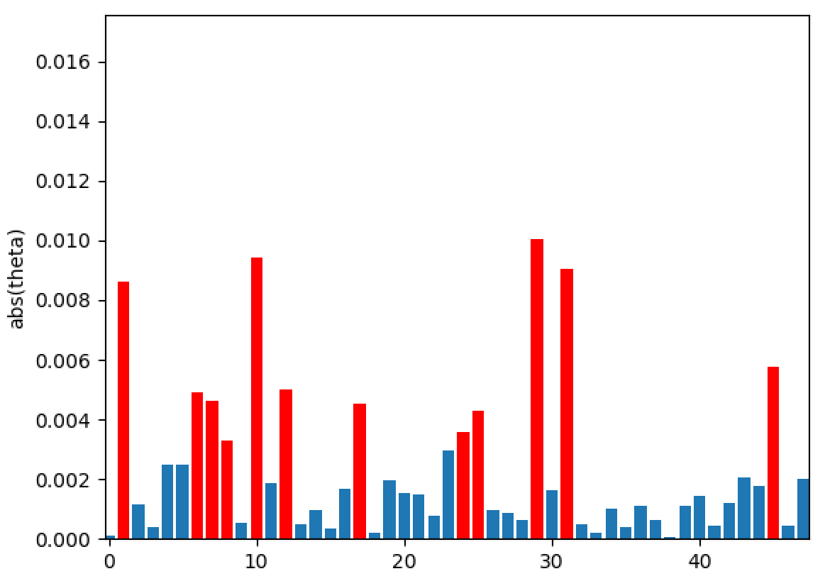
Test (1): Identified relevant inputs, after eliminating input 9395 Main Gas Pressure (OP)
10425 Calculated Cullet Ratio
2922 Closed Bottom Temperature - Downstream Working End (PV)
2913 Closed Bottom Temperature - Port 1 (PV)
2918 Closed Bottom Temperature - Port 6 (PV)
2921 Closed Bottom Temperature - Upstream Working End (PV)
30208 Feeder Speed Measurement Left
10091 Furnace Load
7520 Open Crown Temperature - Upstream Working End (PV)
7443 Outside Ambient Temperature Measurement
11111 Port 2 - 3 Combustion Air Flow LHS (OP)
9400 Port 2 Gas Flow (SP)
9282 Tweel Position

Slide 9
Test (1): Identified relevant inputs Comparison
With 9395 Main Gas Pressure (OP)
Without 9395 Main Gas Pressure (OP)
10425 Calculated Cullet Ratio
2913 Closed Bottom Temperature - Port 1 (PV)
2918 Closed Bottom Temperature - Port 6 (PV)
2921 Closed Bottom Temperature - Upstream Working End (PV)
30208 Feeder Speed Measurement Left
10091 Furnace Load
9395 Main Gas Pressure (OP)
7520 Open Crown Temperature - Upstream Working End (PV)
7443 Outside Ambient Temperature Measurement
11111 Port 2 - 3 Combustion Air Flow LHS (OP)
9400 Port 2 Gas Flow (SP)
9282 Tweel Position
10425 Calculated Cullet Ratio
2922 Closed Bottom Temperature - Downstream Working End (PV)
2913 Closed Bottom Temperature - Port 1 (PV)
2918 Closed Bottom Temperature - Port 6 (PV)
2921 Closed Bottom Temperature - Upstream Working End (PV)
30208 Feeder Speed Measurement Left
10091 Furnace Load
7520 Open Crown Temperature - Upstream Working End (PV)
7443 Outside Ambient Temperature Measurement
11111 Port 2 - 3 Combustion Air Flow LHS (OP)
9400 Port 2 Gas Flow (SP)
9282 Tweel Position
New inputs

Slide 10
Test (2): Data from the second region is used for training
Clean regions
ISRA 5D
Testing
Training

Slide 11
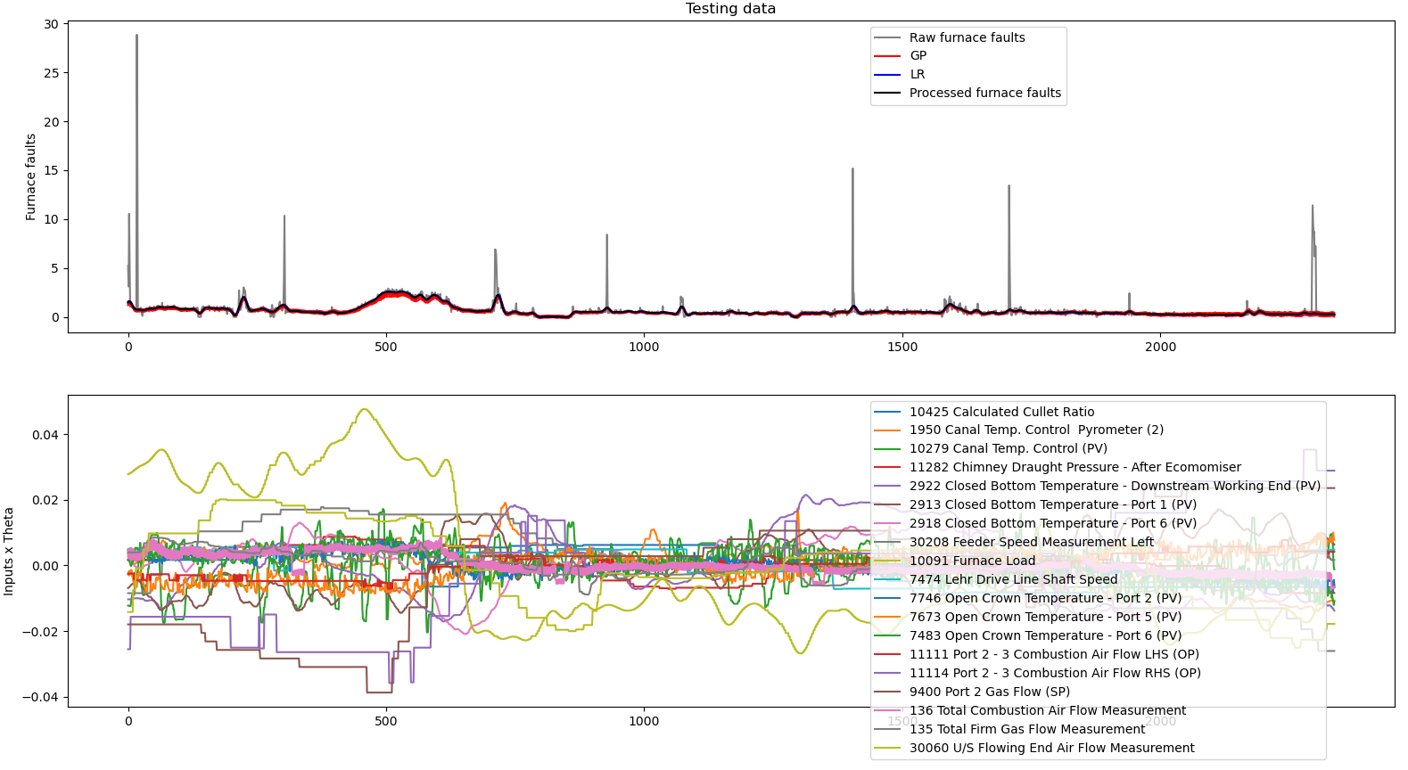
Test (2)

Slide 12
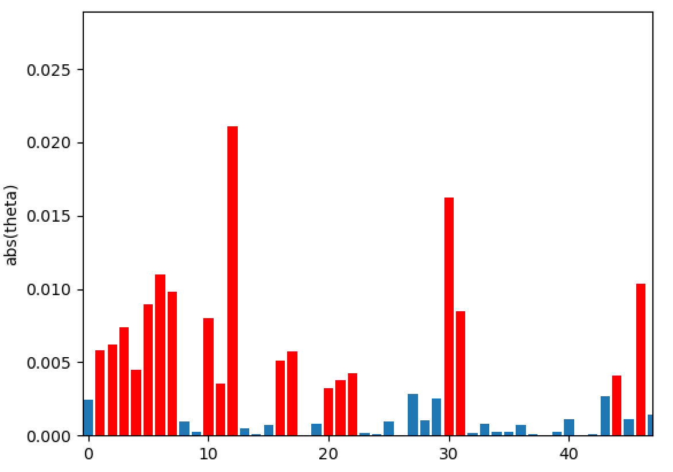
Test (2): Identified relevant inputs
10425 Calculated Cullet Ratio
1950 Canal Temp. Control Pyrometer (2)
10279 Canal Temp. Control (PV)
11282 Chimney Draught Pressure - After Ecomomiser
2922 Closed Bottom Temperature - Downstream Working End (PV)
2913 Closed Bottom Temperature - Port 1 (PV)
2918 Closed Bottom Temperature - Port 6 (PV)
30208 Feeder Speed Measurement Left
10091 Furnace Load
7474 Lehr Drive Line Shaft Speed
7746 Open Crown Temperature - Port 2 (PV)
7673 Open Crown Temperature - Port 5 (PV)
7483 Open Crown Temperature - Port 6 (PV)
11111 Port 2 - 3 Combustion Air Flow LHS (OP)
11114 Port 2 - 3 Combustion Air Flow RHS (OP)
9400 Port 2 Gas Flow (SP)
136 Total Combustion Air Flow Measurement
135 Total Firm Gas Flow Measurement
30060 U/S Flowing End Air Flow Measurement

Slide 13
Test (1): Identified relevant inputs - Comparison
With 9395 Main Gas Pressure (OP)
Without 9395 Main Gas Pressure (OP)
10425 Calculated Cullet Ratio
1950 Canal Temp. Control Pyrometer (2)
10279 Canal Temp. Control (PV)
11282 Chimney Draught Pressure - After Ecomomiser
2922 Closed Bottom Temperature - Downstream Working End (PV)
2913 Closed Bottom Temperature - Port 1 (PV)
2918 Closed Bottom Temperature - Port 6 (PV)
30208 Feeder Speed Measurement Left
11174 Furnace Bottom Temperature 18m D/S of B8
10091 Furnace Load
7474 Lehr Drive Line Shaft Speed
9395 Main Gas Pressure (OP)
7746 Open Crown Temperature - Port 2 (PV)
7673 Open Crown Temperature - Port 5 (PV)
7483 Open Crown Temperature - Port 6 (PV)
11114 Port 2 - 3 Combustion Air Flow RHS (OP)
9400 Port 2 Gas Flow (SP)
135 Total Firm Gas Flow Measurement
30060 U/S Flowing End Air Flow Measurement
10425 Calculated Cullet Ratio
1950 Canal Temp. Control Pyrometer (2)
10279 Canal Temp. Control (PV)
11282 Chimney Draught Pressure - After Economiser
2922 Closed Bottom Temperature - Downstream Working End (PV)
2913 Closed Bottom Temperature - Port 1 (PV)
2918 Closed Bottom Temperature - Port 6 (PV)
30208 Feeder Speed Measurement Left
10091 Furnace Load
7474 Lehr Drive Line Shaft Speed
7746 Open Crown Temperature - Port 2 (PV)
7673 Open Crown Temperature - Port 5 (PV)
7483 Open Crown Temperature - Port 6 (PV)
11111 Port 2 - 3 Combustion Air Flow LHS (OP)
11114 Port 2 - 3 Combustion Air Flow RHS (OP)
9400 Port 2 Gas Flow (SP)
136 Total Combustion Air Flow Measurement
135 Total Firm Gas Flow Measurement
30060 U/S Flowing End Air Flow Measurement
Without
New inputs

Slide 14
MSE scores comparison:
With 9395 Main Gas Pressure (OP) Without 9395 Main Gas Pressure (OP)
Equal MSE score for Linear Regression and slightly better for Gaussian process regression
 | LR | GP
Test (1) | 0.00043 | 0.00393
Test (2) | 0.00129 | 0.00597
Score | 0.00086 | 0.00495
 | LR | GP
Test (1) | 0.00036 | 0.00393
Test (2) | 0.00137 | 0.00543
Score | 0.00086 | 0.00468

Slide 15
List of activities
Comparison of bespoke filter (low-pass filter).
Eliminate input “9395 Main Gas Pressure (OP)” and run then model again.
Show “clean” and “exclusion” periods for the new data provided (2020-2021)
Chose the clean region with the largest number of data points as the training data.
Avoid “information leak” when standardising the training data set.
Include the bias term in the linear regression equation.

Slide 16
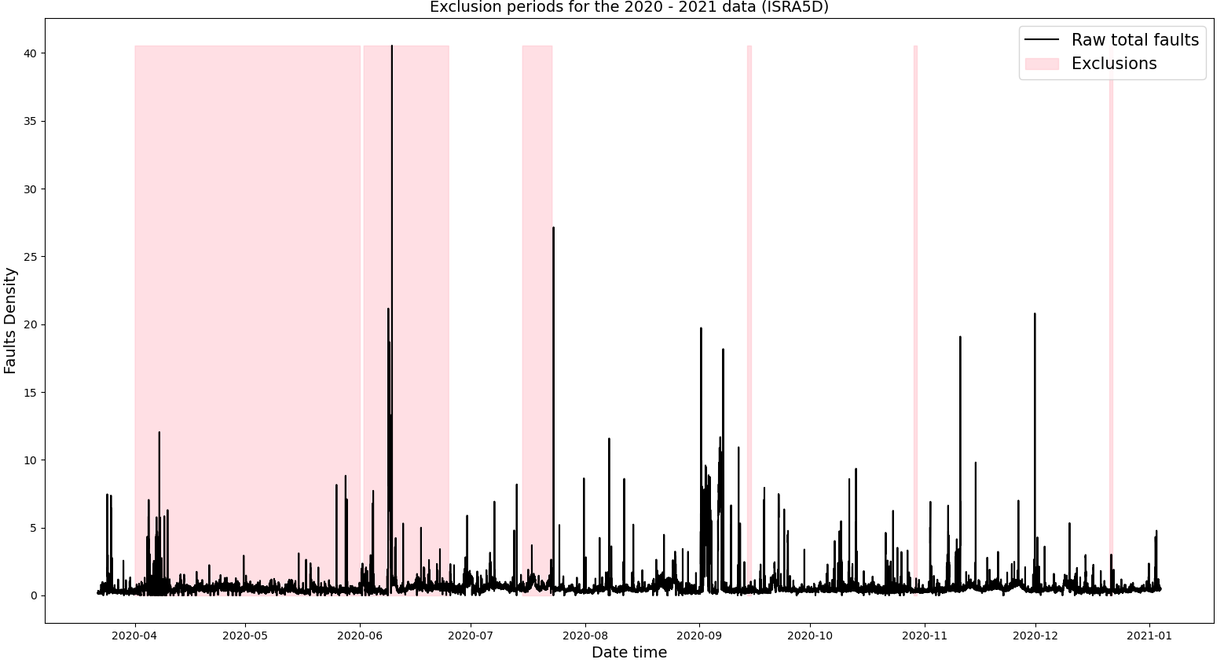
Exclusion periods for the data 2020 - 2021

Slide 17
Exclusion periods for the data 2020 - 2021
1 day
1 day
1 day

Slide 18
Exclusion periods for the data 2020 - 2021
1 day
1 day
1 day
Training data

Slide 19
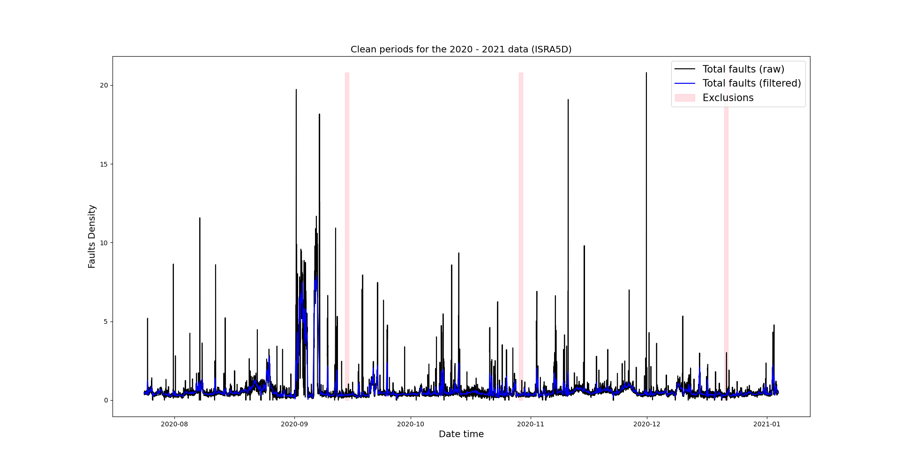
Exclusion periods for the data 2020 - 2021

Slide 20
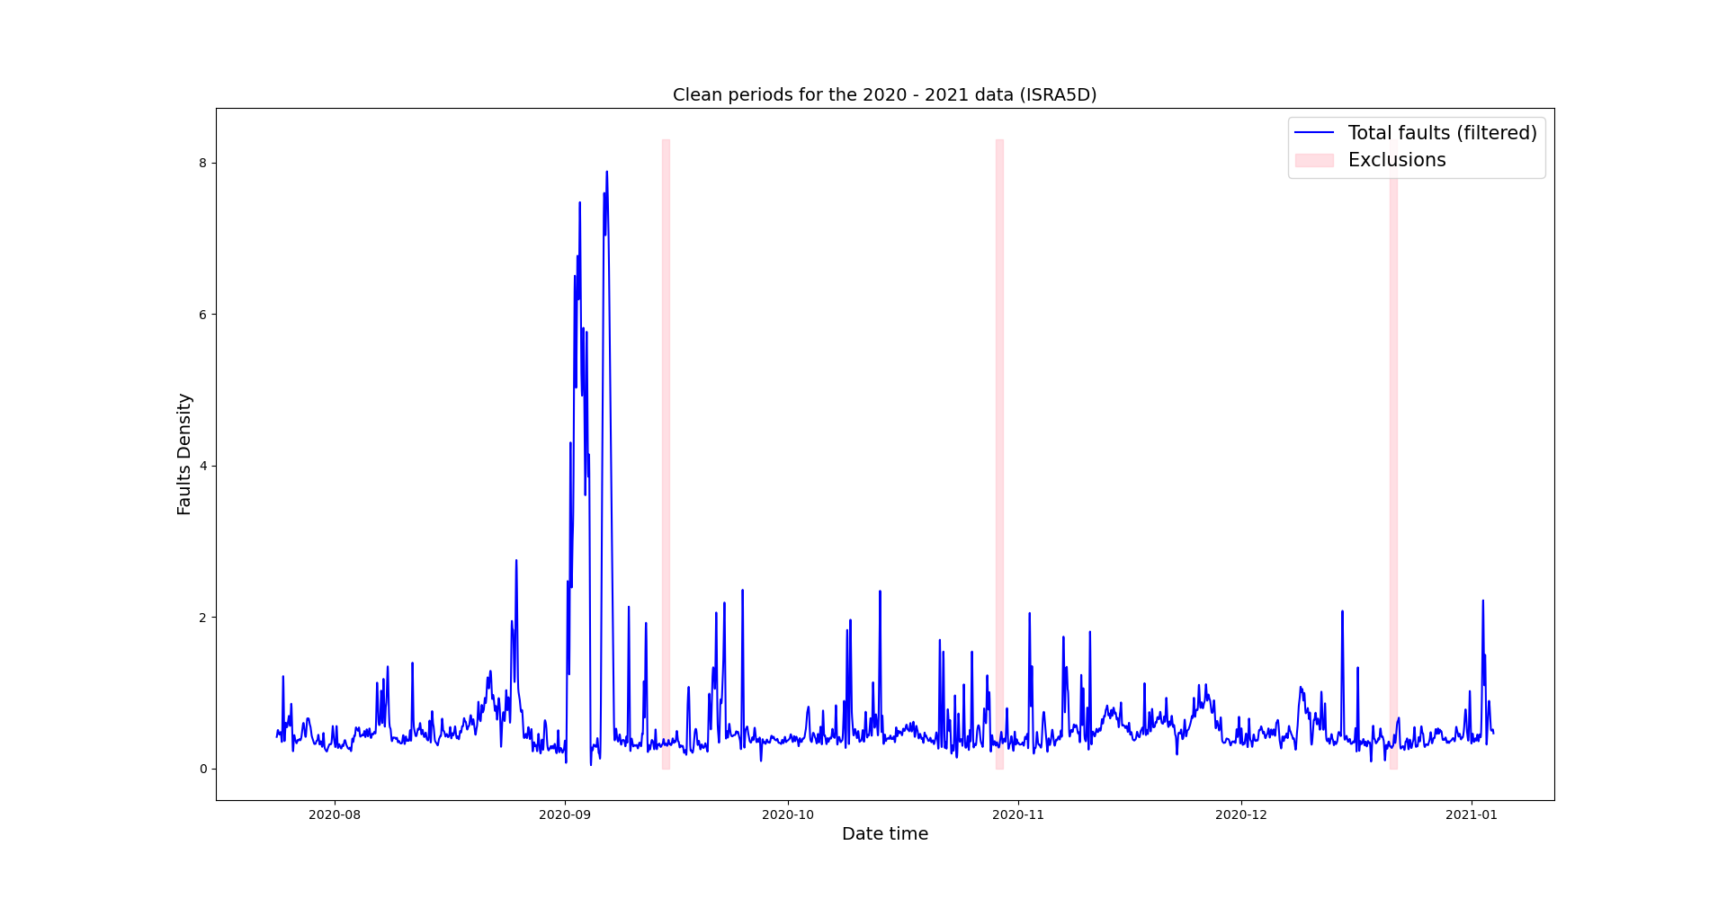
Faults density after removing outliers (Clean region)

Slide 21
Faults density after removing outliers (Clean region)
N = 20735

Slide 22
List of activities
Comparison of bespoke filter (low-pass filter).
Eliminate input “9395 Main Gas Pressure (OP)” and run then model again.
Show “clean” and “exclusion” periods for the new data provided (2020-2021)
Chose the clean region with the largest number of data points as the training data.
Avoid “information leak” when standardising the training data set.
Include the bias term in the linear regression equation.

Slide 23
Standardisation
Cross-validation: Using one set of data for training and another set of data for testing.
We have to standardise both data sets using the same statistics (mean and standard deviation).
Right now we are standardising the training and testing data as follows:
And basically we are creating two different sets of inputs.
The right way to standardise data when using cross-validation is the following:
Train Standardise = (trainData - mean(trainData)) / sd(trainData)
Test Standardise = (testData - mean(testData)) / sd(testData)
Train Standardise = (trainData - mean(trainData)) / sd(trainData)
Test Standardise = (testData - mean(trainData)) / sd(trainData)

Slide 24
List of activities
Comparison of bespoke filter (low-pass filter).
Eliminate input “9395 Main Gas Pressure (OP)” and run then model again.
Show “clean” and “exclusion” periods for the new data provided (2020-2021)
Chose the clean region with the largest number of data points as the training data.
Avoid “information leak” when standardising the training data set.
Include the bias term in the linear regression equation.

Slide 25
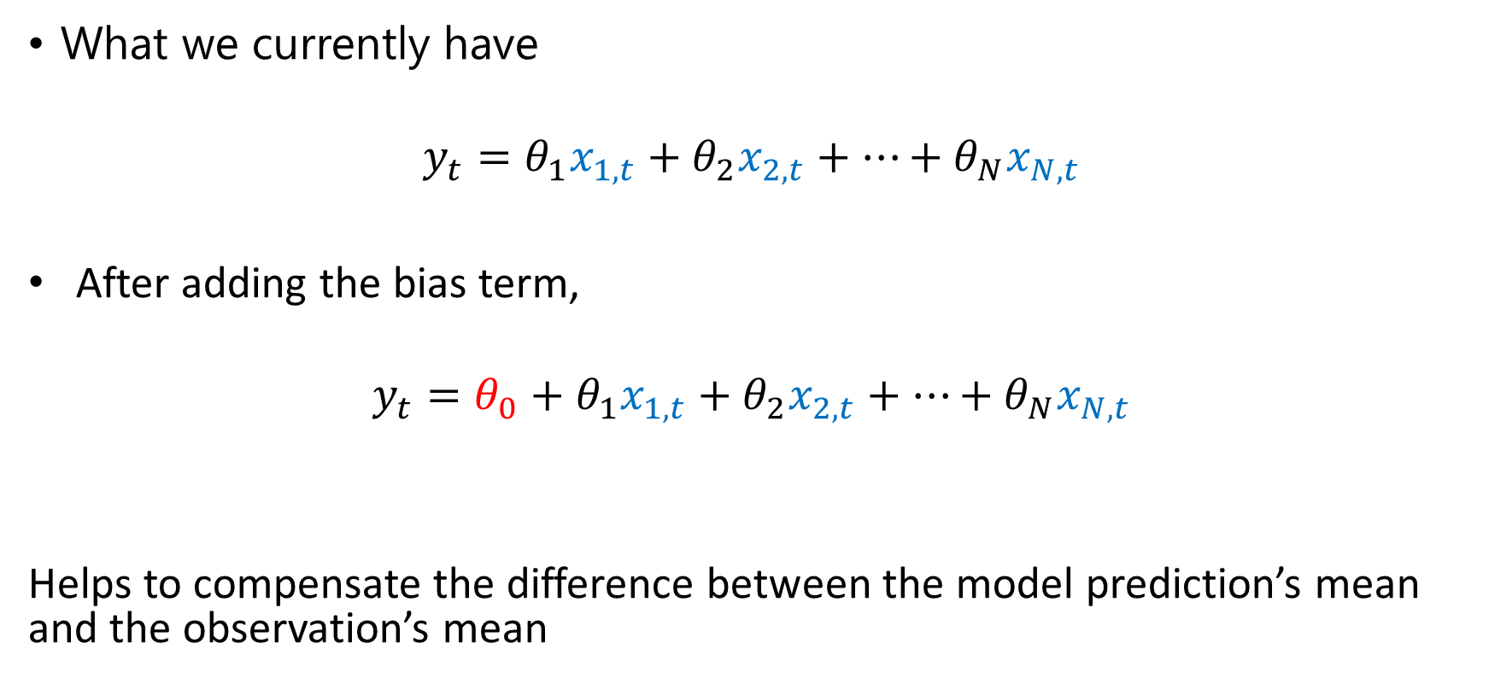
Linear Regression: Lest Squares
What we currently have
$$y_{t}=θ_{1}x_{1,t}+θ_{2}x_{2,t}+…+θ_{N}x_{N,t}$$
After adding the bias term,
$$y_{t}=θ_{0}+θ_{1}x_{1,t}+θ_{2}x_{2,t}+…+θ_{N}x_{N,t}$$
Helps to compensate the difference between the model prediction’s mean and the observation’s mean
Bias term

Slide 26

Linear Regression: Lest Squares
After adding the bias term,
$$y_{t}=θ_{0}+θ_{1}x_{1,t}+θ_{2}x_{2,t}+…+θ_{N}x_{N,t}$$
$$θ_{0}=mean\left(y\right)−\sum_{j=1}^{M−1}{θ_{j} mean{\left(w\right)}_{j}}$$
In this case $M$ is the number of inputs

Slide 27
Next activities
Standardise the training and testing data outside the pipeline.
Train the model using the 2020-2021 data and test the model using the 2019-2020 data.
Change the time lags randomly.
Predictions beyond 20 minutes.

Slide 28
Thank you for your attention. ANY QUESTIONS?

Slide 29
